Slide 1
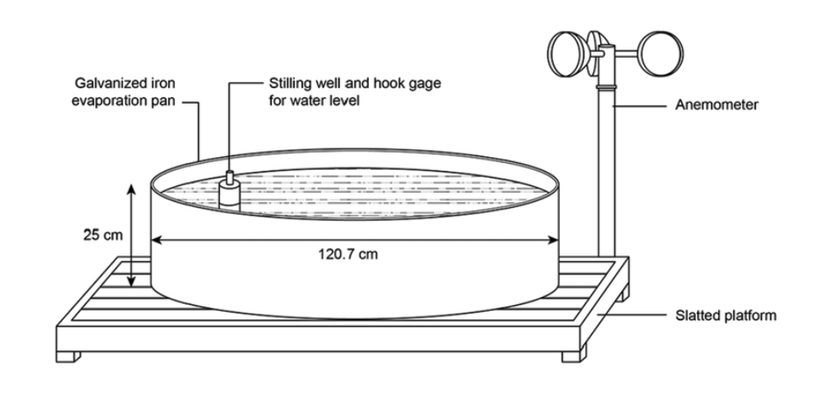
Digital Evaporimeter
Mentor:
Dr. Anantha Narayanan V.
Dr. B Soundharajan
ARUNKUMAR J [CB.EN.U4CSE21106]
ASHWIN SHARMA [CB.EN.U4CSE21108]
KAMALESH L [CB.EN.U4CSE21127]

Slide 2
Model Overview
Temperature Sensor
Wind Speed Sensor
Monitors air temperature, critical for evaporation
Records wind speed, a key evaporation factor.
Evaporimeter
Humidity Sensor
Measures evaporation rates for precise environmental monitoring.
Measures humidity, assessing atmospheric moisture impact.
Water Quality sensor
Rain Drop Module
Evaluates water quality, ensuring optimal conditions.
Data Acquisition
Quantifies rainfall by size and frequency measurement.

Slide 3
Supervisory Control
Irrigation Scheduling
Data Logging
Optimizes schedules, recommends water quantities, ensuring efficient crop growth.
03
04
Stores historical data for trend analysis, performance monitoring, and informed decision-making.
Sensor Integration
02
05
Analytics
Includes various sensors for real-time environmental data crucial for irrigation planning.
Analyzes data for insights, improving decision-making.
Alarm and Notification
01
06
User Interface & Reporting
Incorporates alerts for deviations, malfunctions, or critical events, ensuring prompt attention.
Intuitive interfaces and reporting tools for data visualization, analysis, and informed decision-making.

Slide 4

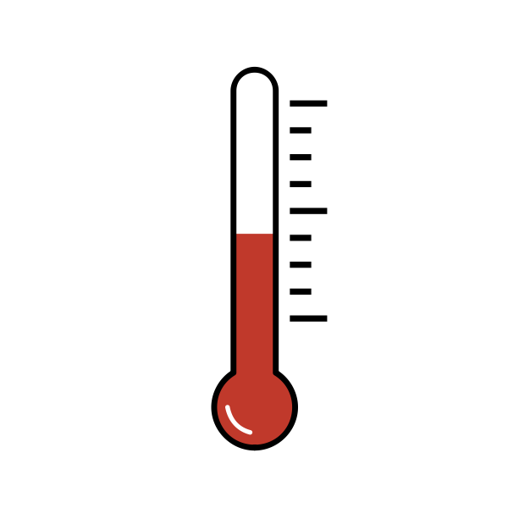


Sensor Placement Model
Position the sensor at the center of the evaporation pan to accurately measure water level changes.
·
Install the temperature sensor at a height above the evaporation pan to capture air temperature accurately.
·
Position the humidity sensor at a level where it can capture ambient moisture levels.
·
Mount the wind speed sensor at an elevated position to capture undisturbed wind flow.

Slide 5
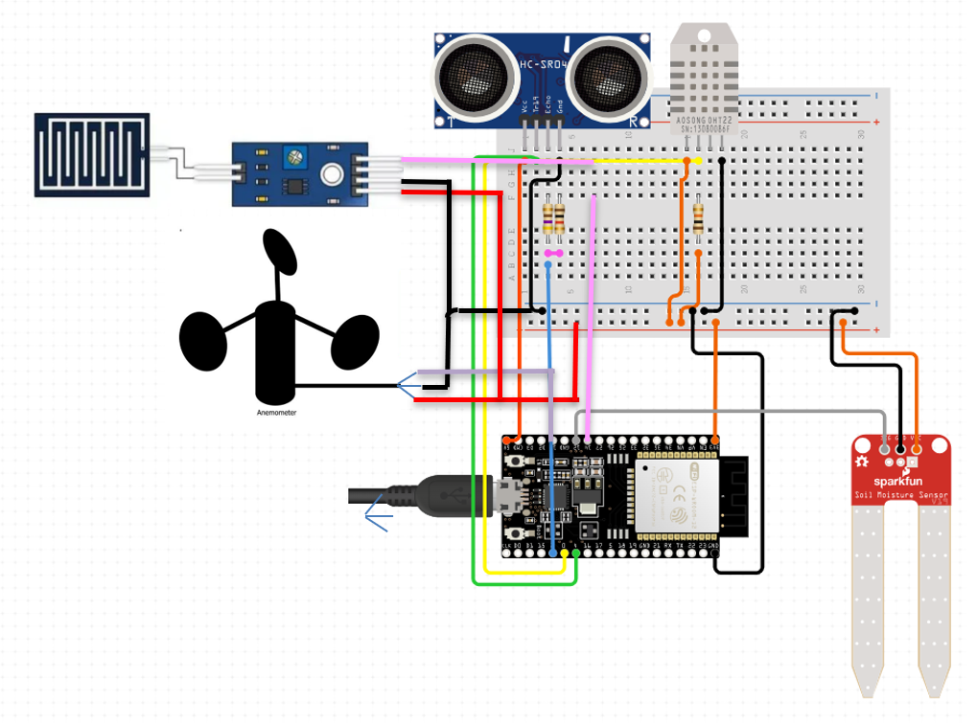
Control Unit Design
ESP32
Evaporimeter
25%
35%
Temperature and Humidity sensor
Soil Moisture sensor
10%
40%
Anemometer
Soil Moisture sensor

Slide 6


Communication and Transmission protocol
Leveraging Wi-Fi technology allows for high-speed data transfer and compatibility with existing infrastructure
MQTT is chosen as the transmission protocol for its efficiency in constrained IoT environments
To secure data transmission between the ESP32 and AWS cloud,
HTTPS is implemented.

Slide 7
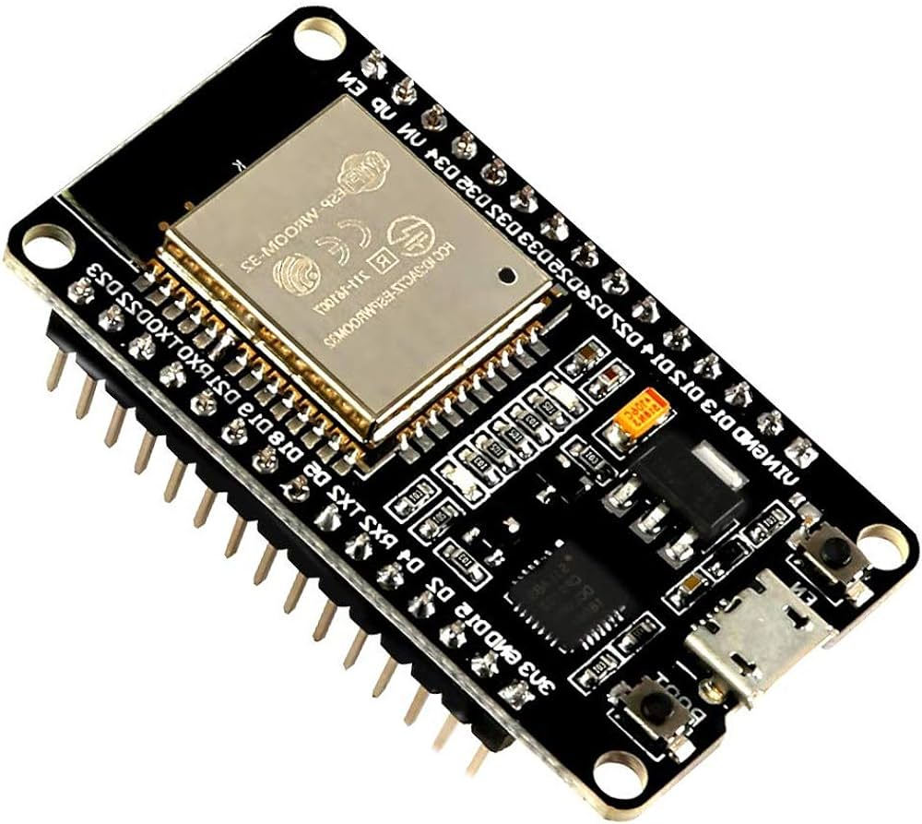
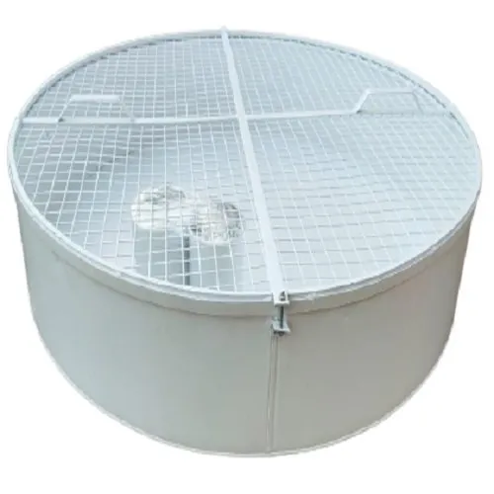
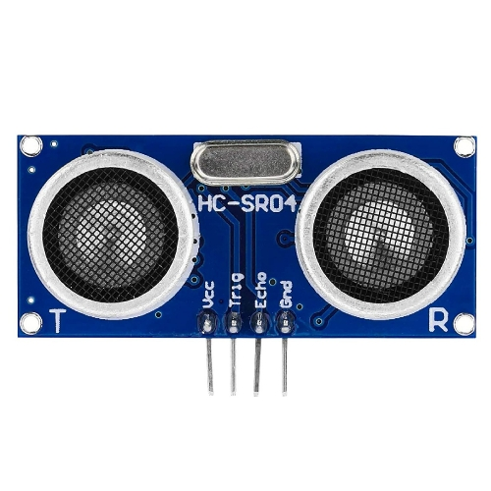
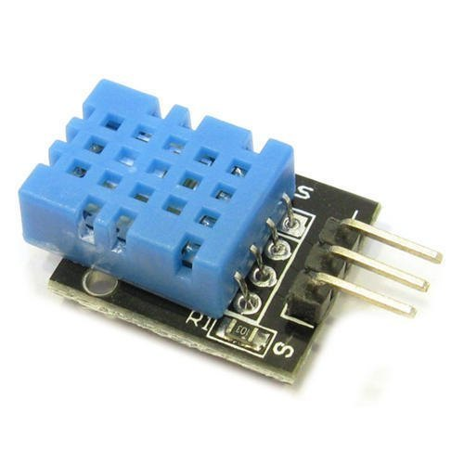
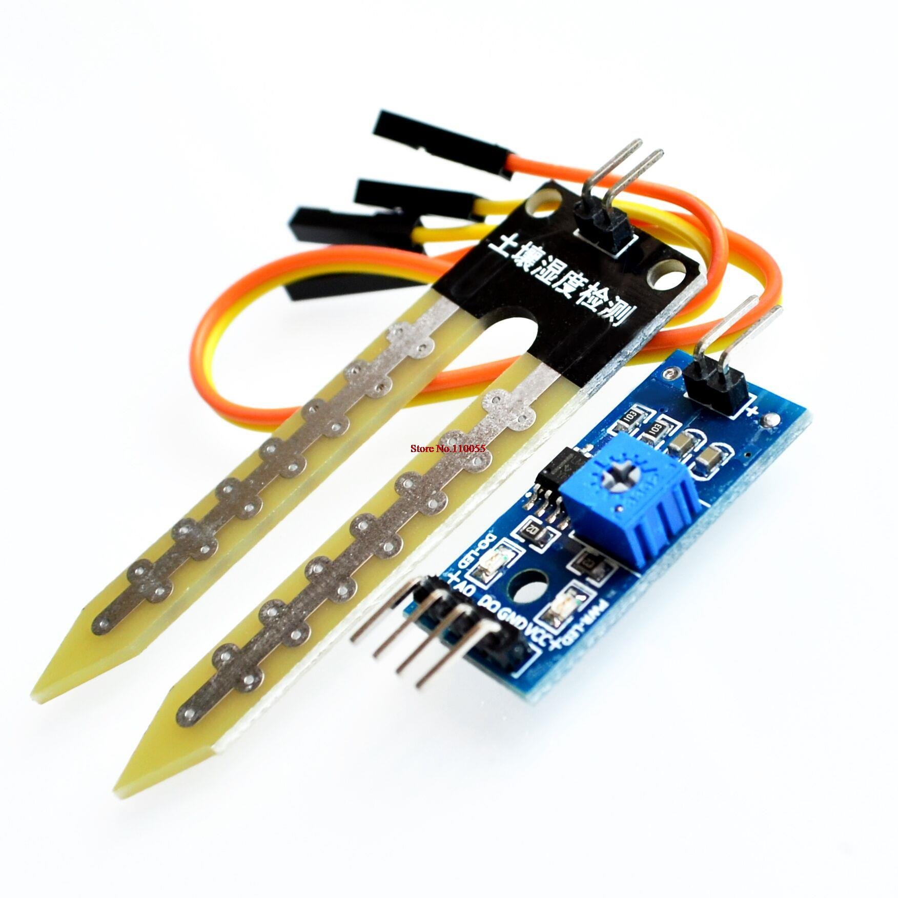
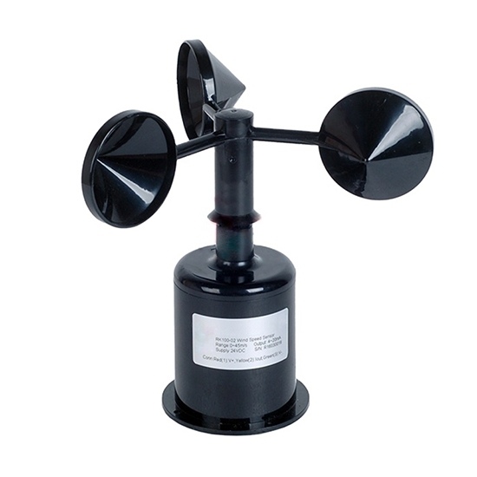
Hardware Components
ESP32
Evaporimeter
Microcontroller with low power consumption
Measures water levels in the evaporation pan
UltraSonic Sensor
Temperature and humidity Sensor
Measures the distance to an object
Measures temperature and moisture
Soil Moisture Sensor
Wind Speed Sensor
Measures moisture content in soil
Measures the wind speed

Slide 8
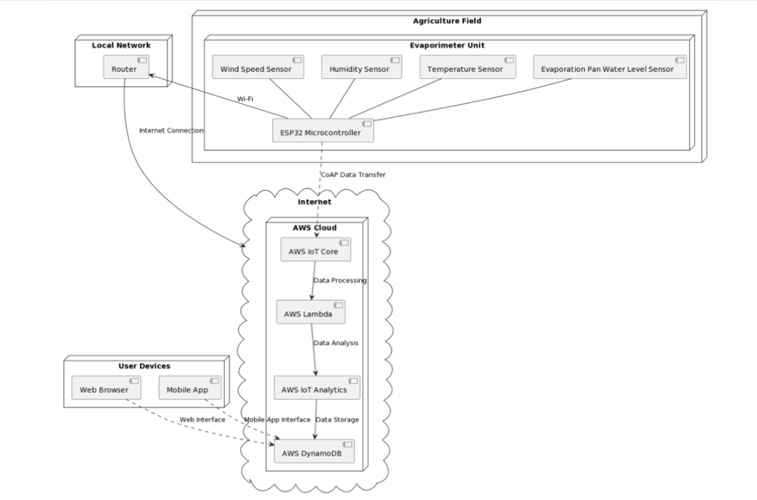
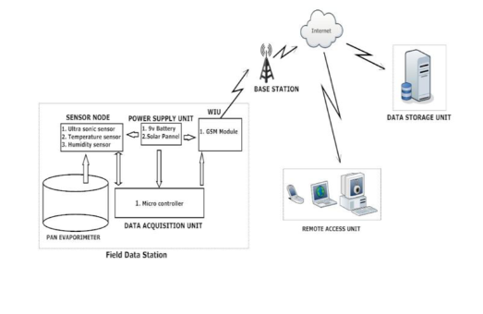
Deployment level Diagram

Slide 9
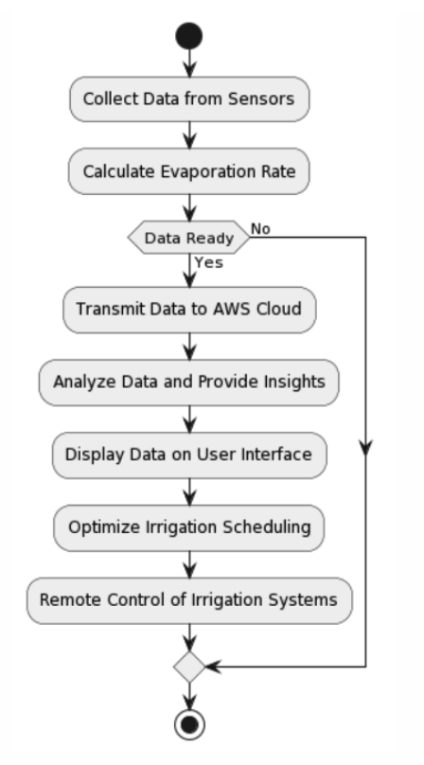
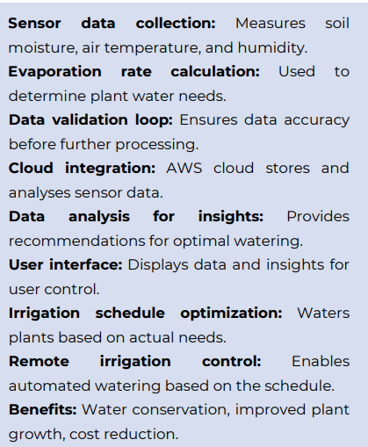
Flow Chart

Slide 10
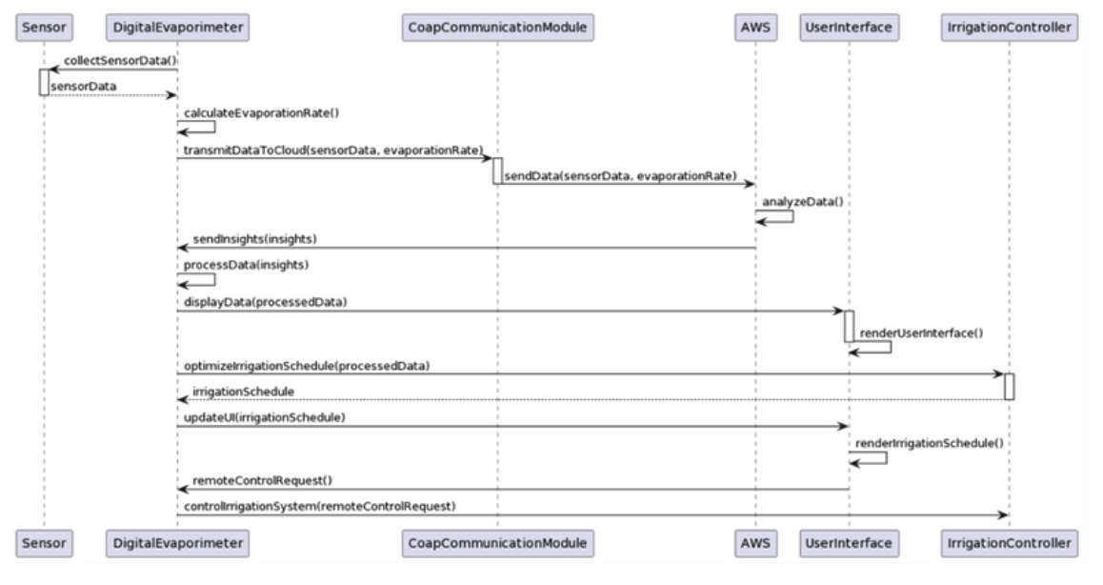
Sequence Diagram
MQTT
MQTT

Slide 11
Data Analytics
Cloud Analytics
Edge Analytics
Powerful and scalable analysis for comprehensive insights.
Real-time calculations enhance quick decision-making.
Stores historical data for long-term planning.
Immediate control of irrigation systems with local data.
Optimizes irrigation systems with centralized computational capabilities.
Efficient, reducing reliance on centralized cloud computations.

Slide 12
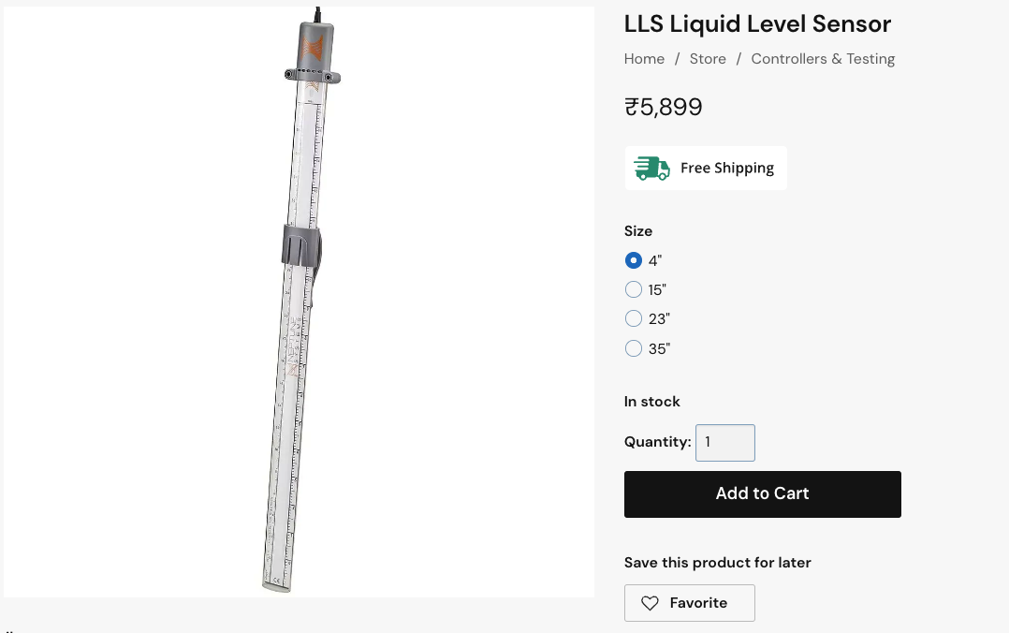
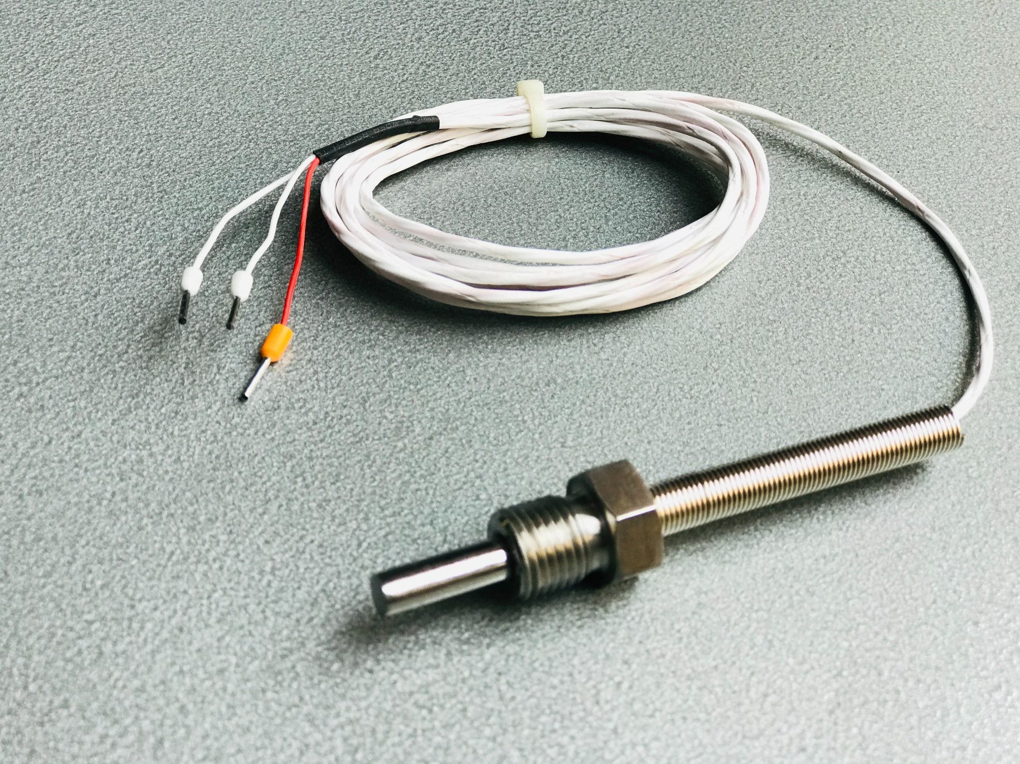
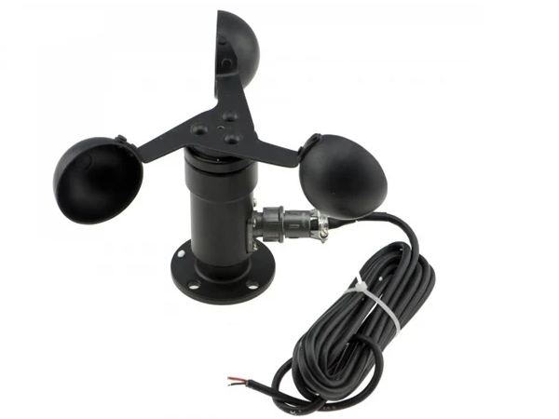
Industrial Sensor
PT100 Temperature Sensor
Wind speed sensor
Liquid level sensor

Slide 13
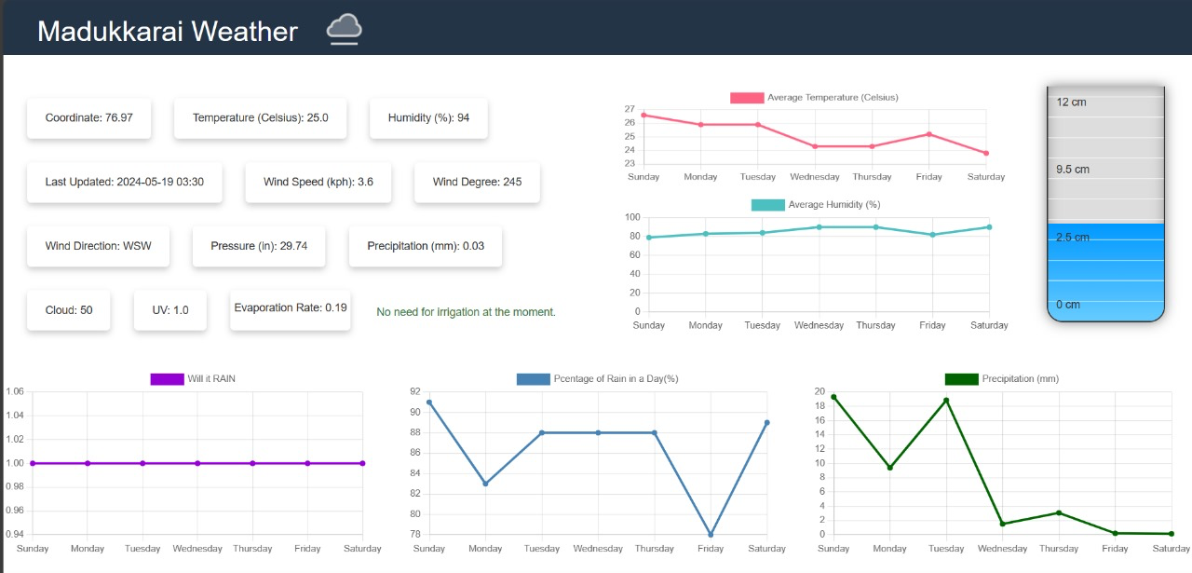
Web App

Slide 14
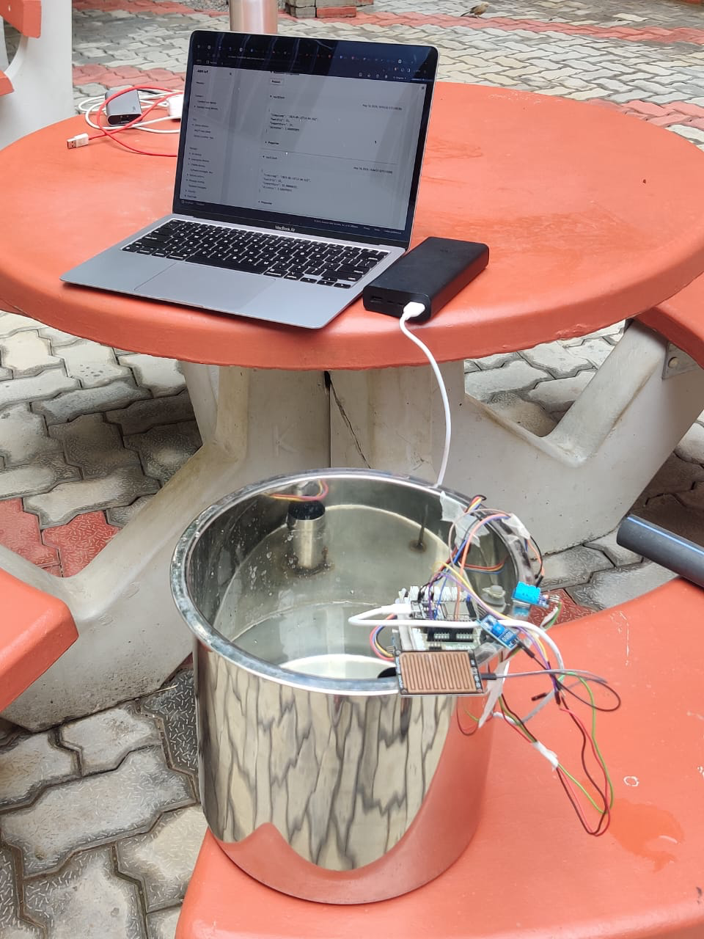
Prototype
Model

Slide 15
Thank You

